Slide 1
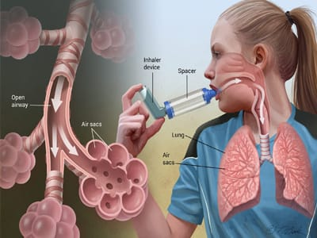
ASTHMA DISEASE DATASET
DHARANI .A

Slide 2
INTRODUCTION
Asthma is a lung disease where a person's airways become inflamed and narrow and also produce extra mucus, which makes a person difficult to breathe.
This is a very common medical condition in India which affected more than 10 million people .
Asthma may caused by certain allergies to dust and hard smokes which affects a person's airways and it can be genetic too.

Slide 3
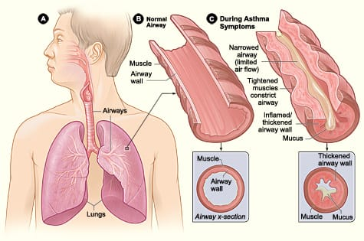

Slide 4
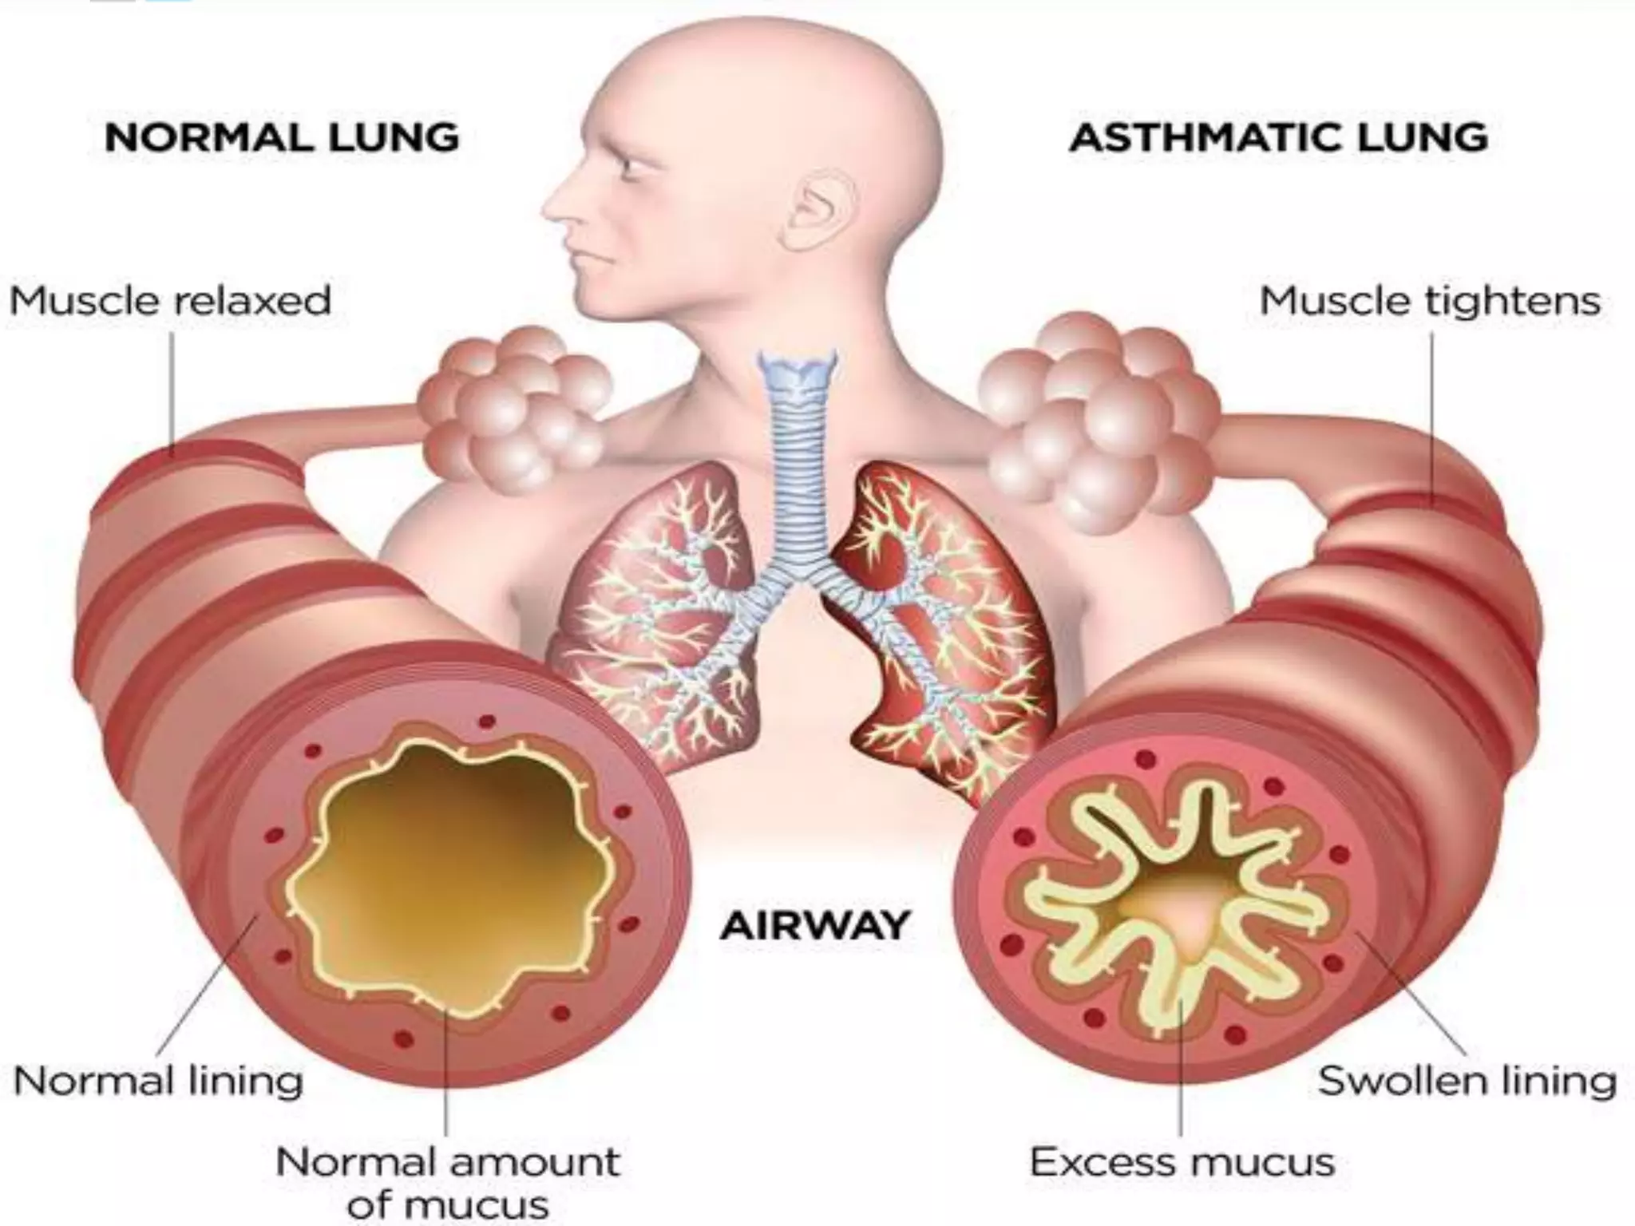

Slide 5
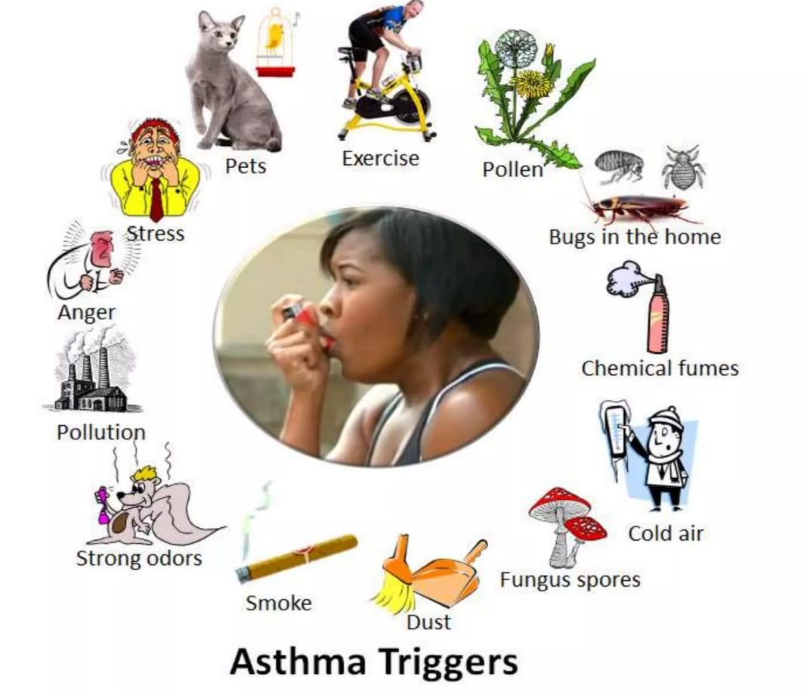

Slide 6
TYPES OF ASTHMA
Allergic Asthma - it is something which affects the airways through irritable substance that inhaled through air.
Non allergic Asthma - it is triggered by non allergic reactions.
Mixed Asthma - it is the combination of both allergic and non allergic asthma and it is the most common form of asthma

Slide 7
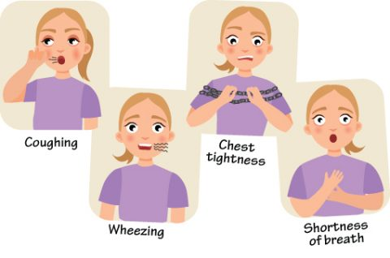
THE SIGNS OF ASTHMA
Pain or pressure in chest
Coughing (especially at night)
Shortness of breath
Wheezing

Slide 8

PROJECT DESCRIPTION
Patient Information
Lifestyle Factors
Environmental and Allergy Factors
Medical History
Clinical Measurements
Symptoms
Diagnosis Information

Slide 9
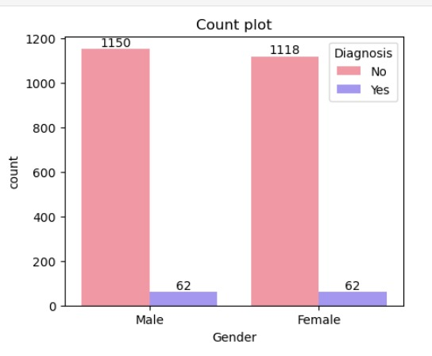
COUNT PLOT
The count plot provided shows the distribution of asthma diagnosis among males and female.
The plot compares the counts of males and female who were diagnosed with asthma and those who were not.
The categories are split into "No" and "Yes “No indicating no asthma diagnosis, Yes indicate Yes asthma diagnosis
There are more males (1150) than females (1118)
The number of diagnosed cases is the same for both males and female 62.

Slide 10
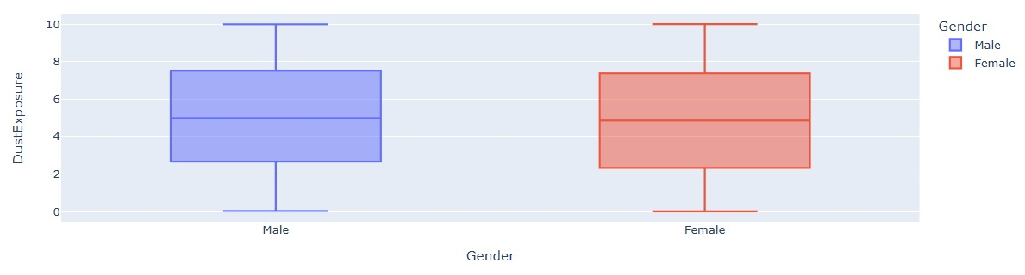
BOXPLOT
The box plot shows the distribution of Gender and Dust Exposure
Male –Dust Exposure
Median dust exposure is around 4.98.
The interquartile range (IQR) is from approximately 2.655 to 7.515.
Minimum dust exposure is 0.02.
Maximum dust exposure is 9.99.
Males have a wider range of dust exposure compared to females.
The spread of dust exposure values is larger in males

Slide 11
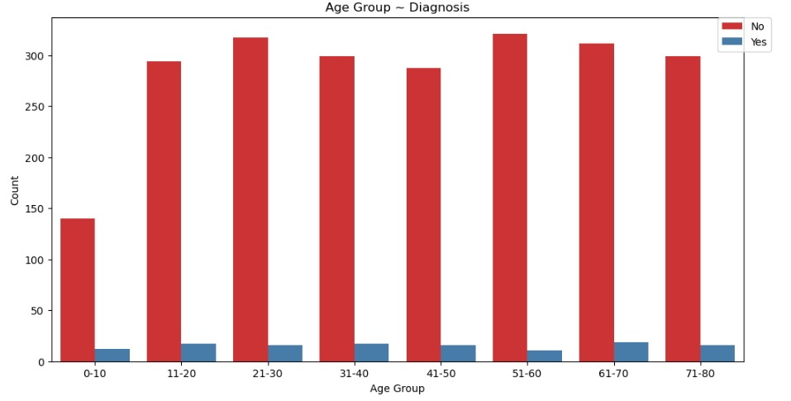
BARPLOT
The highest count of people not affected in diagnosis age group is (51-60)
The highest count of diagnoses affected the age group is (11-40)

Slide 12
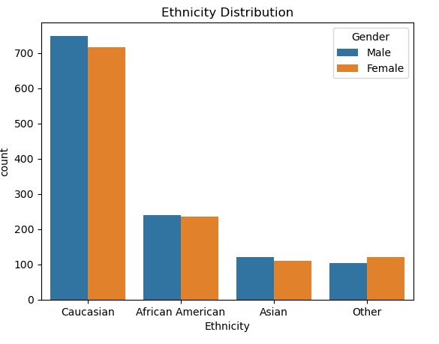
ETHNICITY DISTRIBUTION
The plot categorizes individuals into four ethnic groups: Caucasian, African American, Asian, and Other.
Caucasian: The largest group, with approximately 700 males and 600 females.
African American: The second largest group, with around 250 males and slightly fewer females.
Asian: The third largest group, with close to 100 males and a similar number of females.
Other: The smallest group, with less than 100 individuals of each gender.
Overall, the plot shows that the Caucasian group has the highest count, followed by African American, Asian, and then Other.

Slide 13
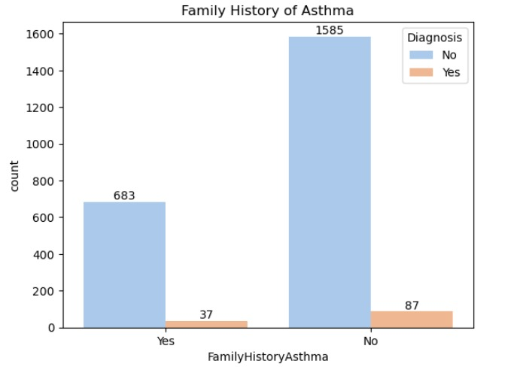
FAMILY HISTORY OF ASTHMA
There is no link between family history of asthma Vs diagnosis because both categories of diagnosis ratio of similar.
Yes radio value 5.14 , No radio value =5.203

Slide 14
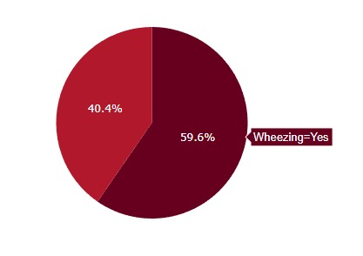
PIE - CHART
From Asthma Disease Dataset, we have totally 2,392 people's information.
59.6% of the people in the dataset have wheezing.
40.4% of the people in the dataset do not have wheezing.

Slide 15
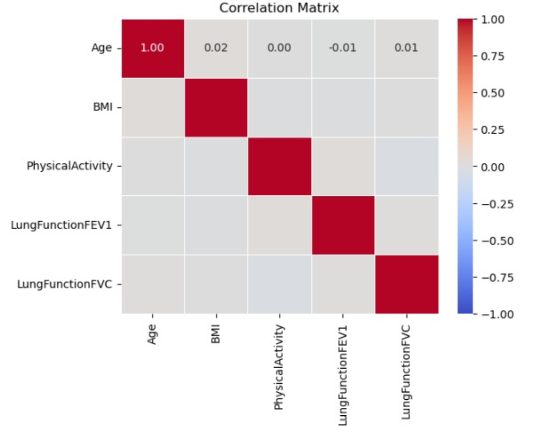
HEATMAP
0.01-Very weak negative correlation (almost no relationship)
0.01-Very weak positive correlation (almost no relationship)
0-no relation
0.02-Very weak positive correlation (no relationship)
Most of the variables show very weak correlations with each other, with correlation coefficients close to zero.
This indicates that there is little to no linear relationship between these variables

Slide 16
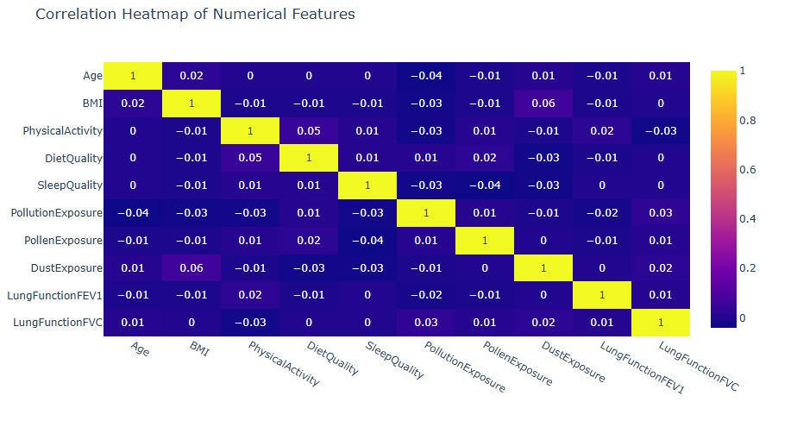
HEATMAP
There are no correlation between these column.
based on our data there are no correlation.

Slide 17
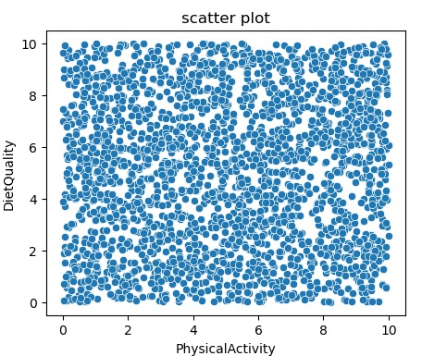
SCATTERPLOT
The scatter plot shared visualizes the relationship between two variables: "Physical Activity" (x-axis) and "Diet Quality" (y-axis).
There is no clear linear trend observable in the scatter plot.
The scatter plot indicates that there is a wide range of "Physical Activity" and "Diet Quality" among the individuals with no strong correlation between the two variables.

Slide 18

STATISTICAL ANALYSIS
Independent samples T – Test
H0 => mean1 = mean2 (population mean of male is equal to female)
HA => mean1 =! mean2 (population mean of male is different from female)
Chi-Square Test
H0 = No link between Family history
of asthma & diagnosis
H1 = There is a link between Family history
of asthma & diagnosis

Slide 19
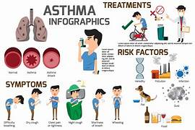
CONCLUSION
In conclusion, asthma is a chronic respiratory disease that requires ongoing management to prevent Symptoms.
With the proper treatments , healthy foods and lifestyle modifications, people with asthma can lead active and healthy lives.

